Slide 1
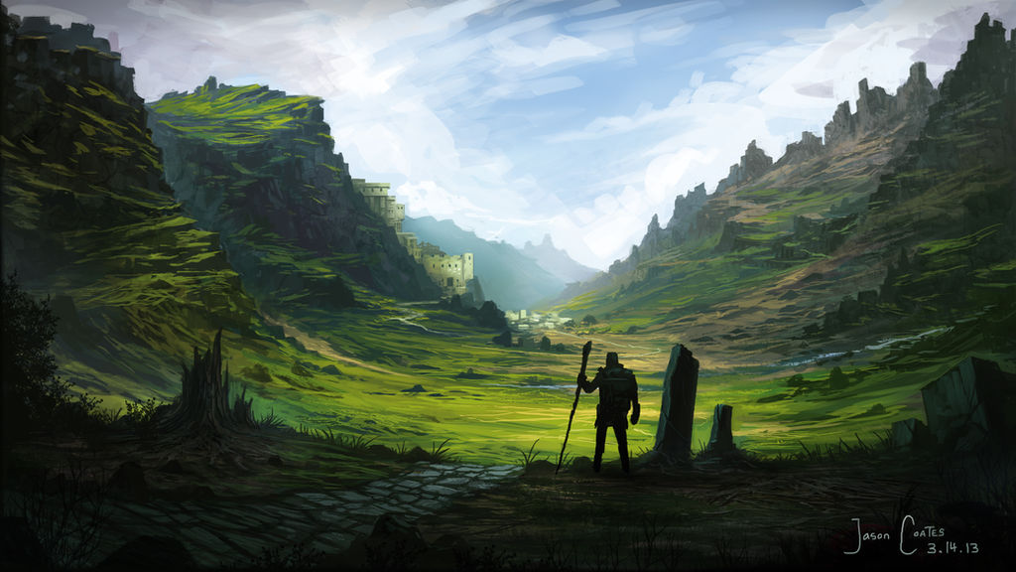
Notes:
1 - Scenery
2 - Dragon Attack
3 - Verrona Attack
4 - Abandoned Building
5 - A Great Fissure
6 - Commoners Passing
7 - Wyrmlings Passage
8 - Intriguing Opening
9 - Exynn Attacks
10 - Mystical Tower

Slide 2
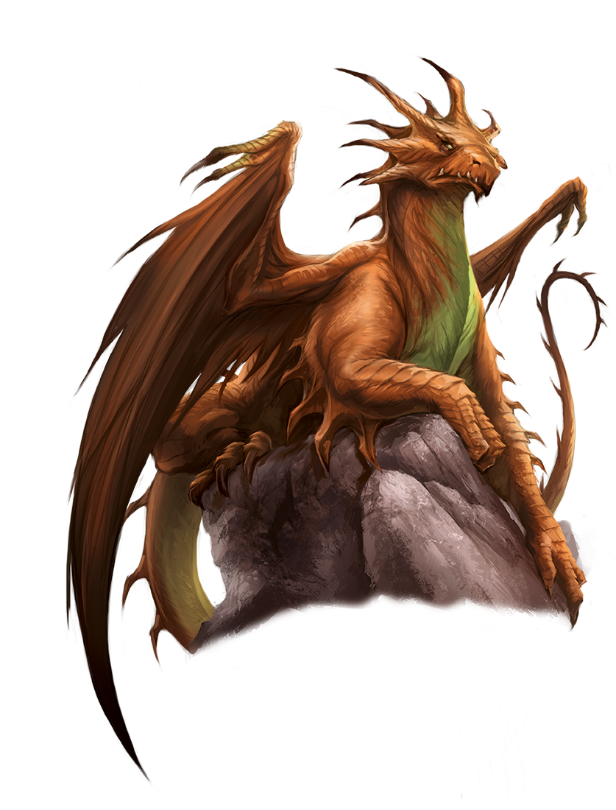
Notes:
1 - Scenery
2 - Dragon Attack
3 - Verrona Attack
4 - Abandoned Building
5 - A Great Fissure
6 - Commoners Passing
7 - Wyrmlings Passage
8 - Intriguing Opening
9 - Exynn Attacks
10 - Mystical Tower

Slide 3
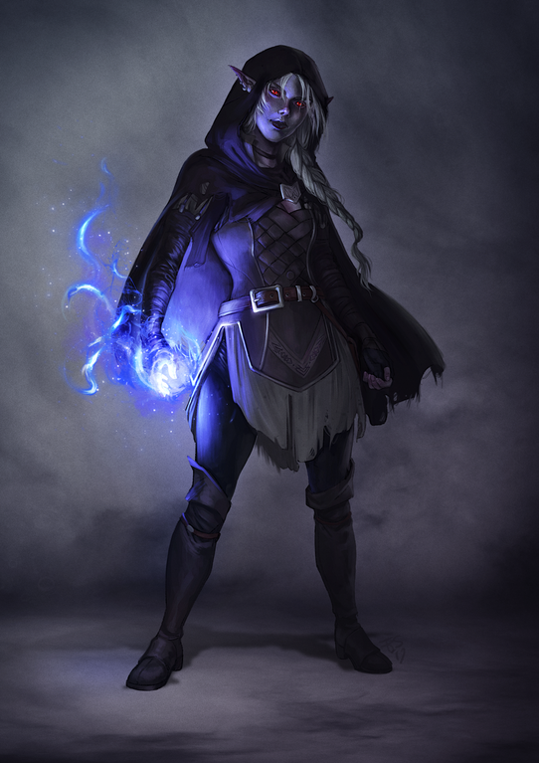
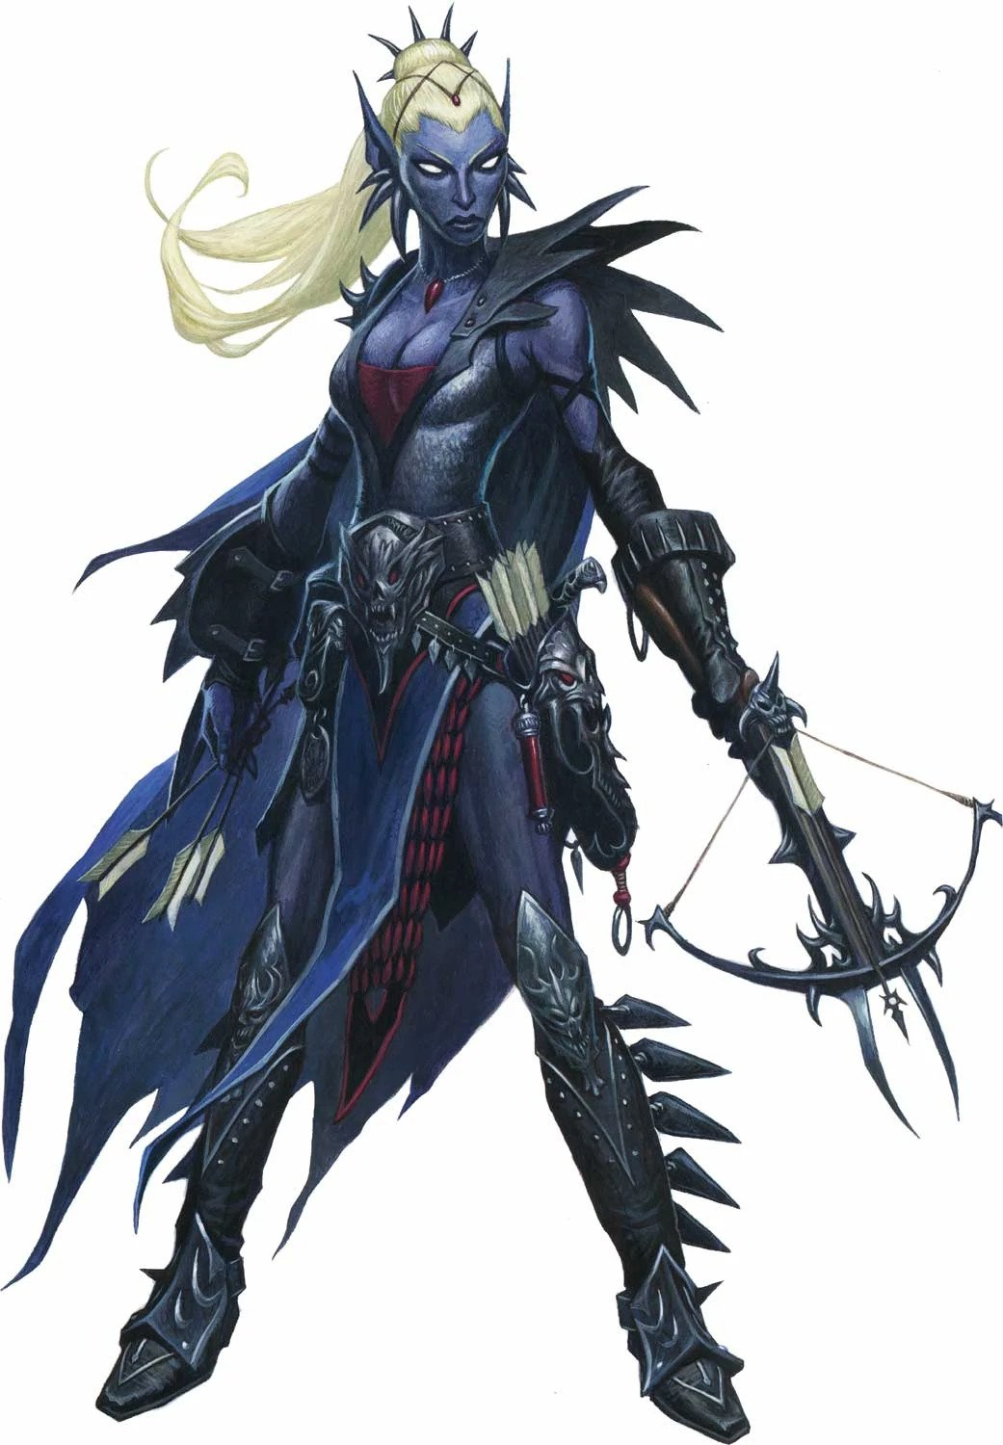
Notes:
1 - Scenery
2 - Dragon Attack
3 - Verrona Attack
4 - Abandoned Building
5 - A Great Fissure
6 - Commoners Passing
7 - Wyrmlings Passage
8 - Intriguing Opening
9 - Exynn Attacks
10 - Mystical Tower

Slide 4
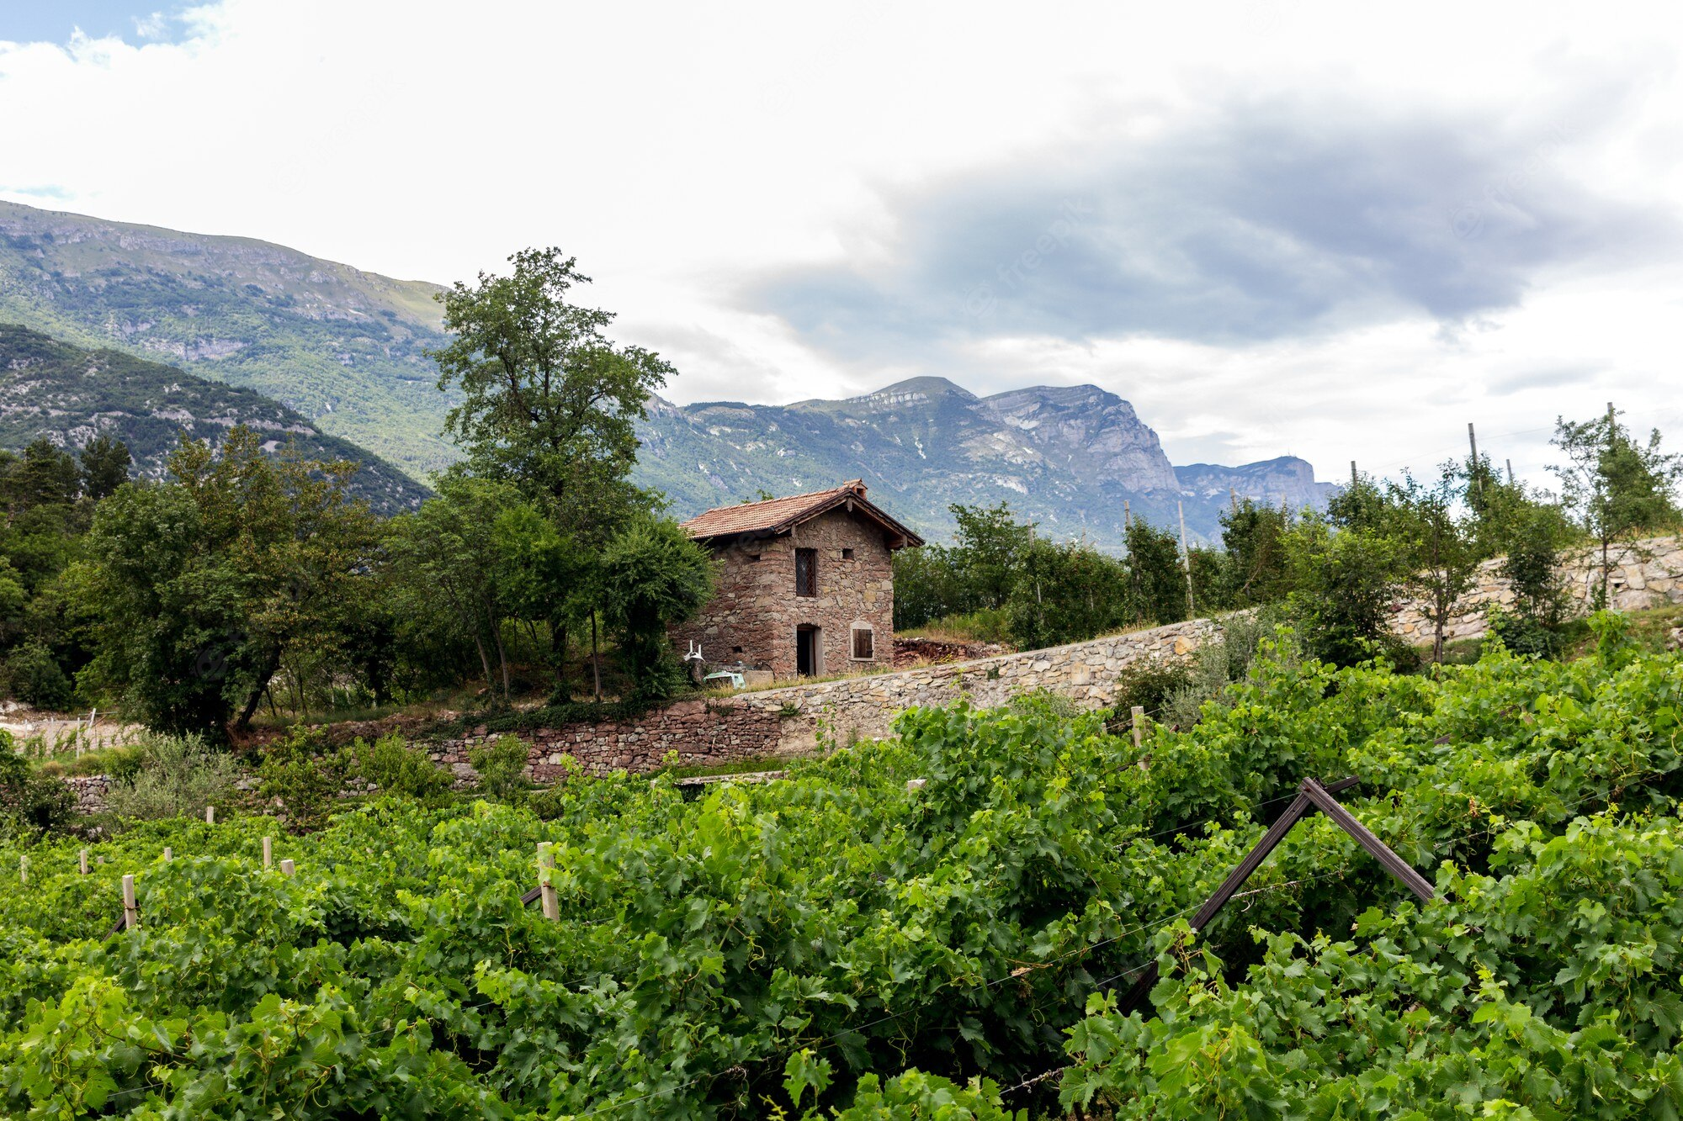
Notes:
1 - Scenery
2 - Dragon Attack
3 - Verrona Attack
4 - Abandoned Building
5 - A Great Fissure
6 - Commoners Passing
7 - Wyrmlings Passage
8 - Intriguing Opening
9 - Exynn Attacks
10 - Mystical Tower

Slide 5
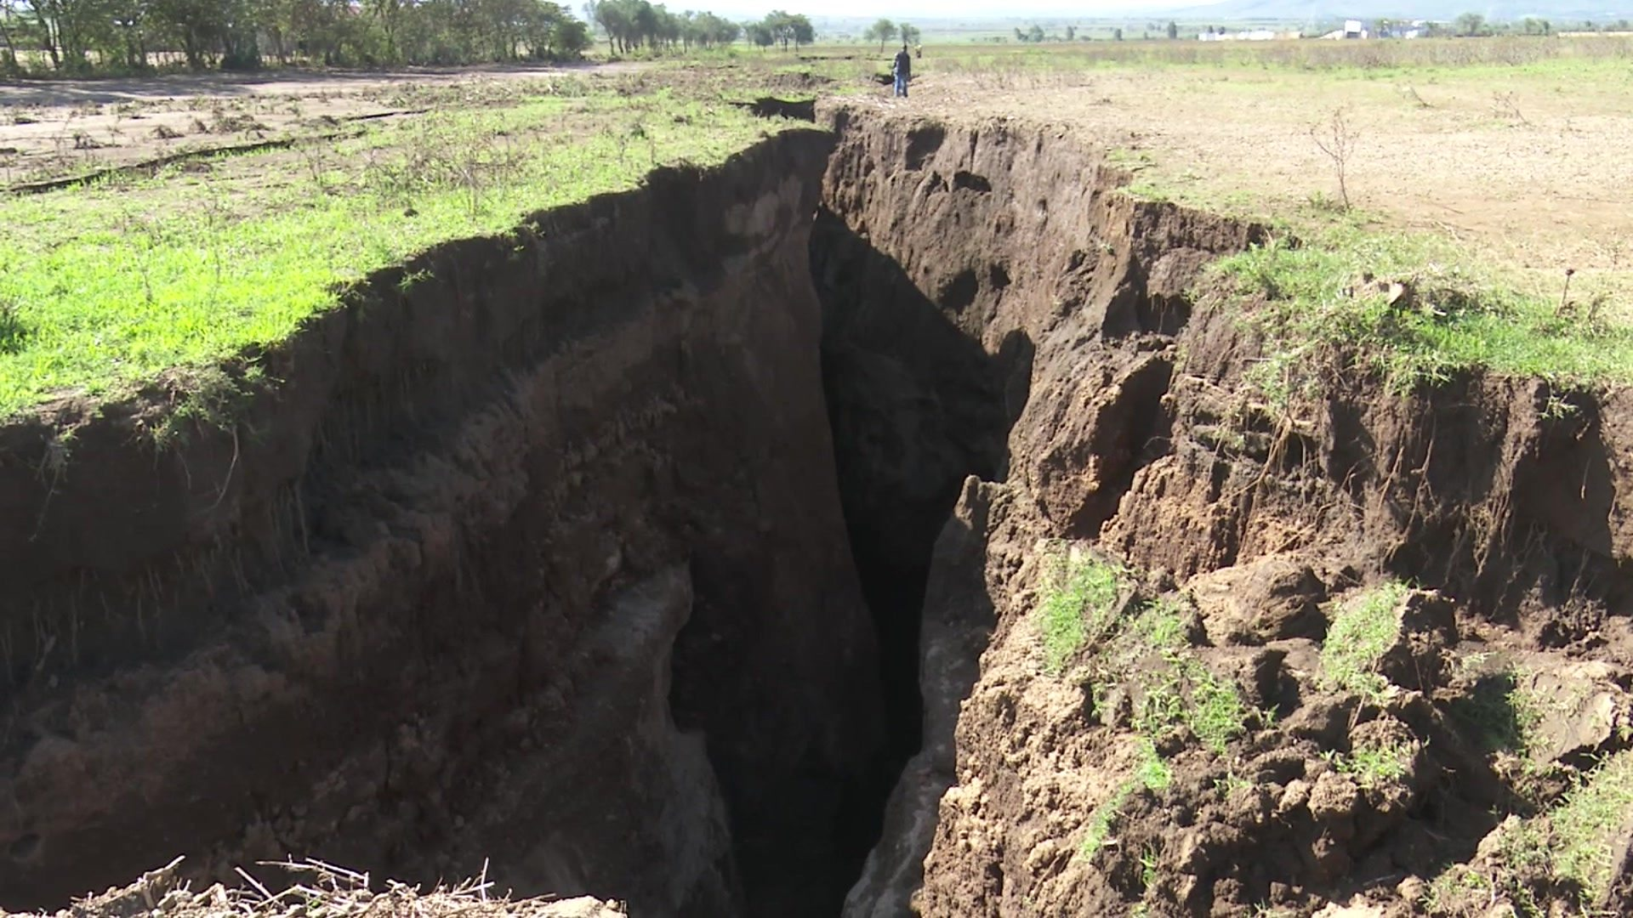
Notes:
1 - Scenery
2 - Dragon Attack
3 - Verrona Attack
4 - Abandoned Building
5 - A Great Fissure
6 - Commoners Passing
7 - Wyrmlings Passage
8 - Intriguing Opening
9 - Exynn Attacks
10 - Mystical Tower

Slide 6

Notes:
1 - Scenery
2 - Dragon Attack
3 - Verrona Attack
4 - Abandoned Building
5 - A Great Fissure
6 - Commoners Passing
7 - Wyrmlings Passage
8 - Intriguing Opening
9 - Exynn Attacks
10 - Mystical Tower

Slide 7
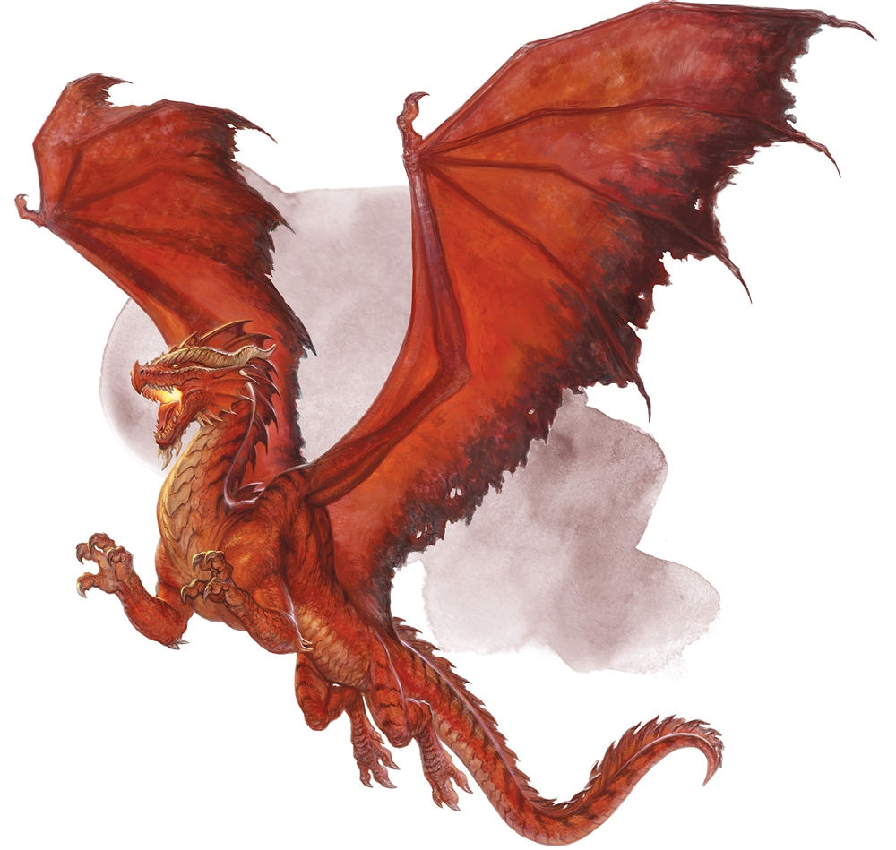
Notes:
1 - Scenery
2 - Dragon Attack
3 - Verrona Attack
4 - Abandoned Building
5 - A Great Fissure
6 - Commoners Passing
7 - Wyrmlings Passage
8 - Intriguing Opening
9 - Exynn Attacks
10 - Mystical Tower

Slide 8
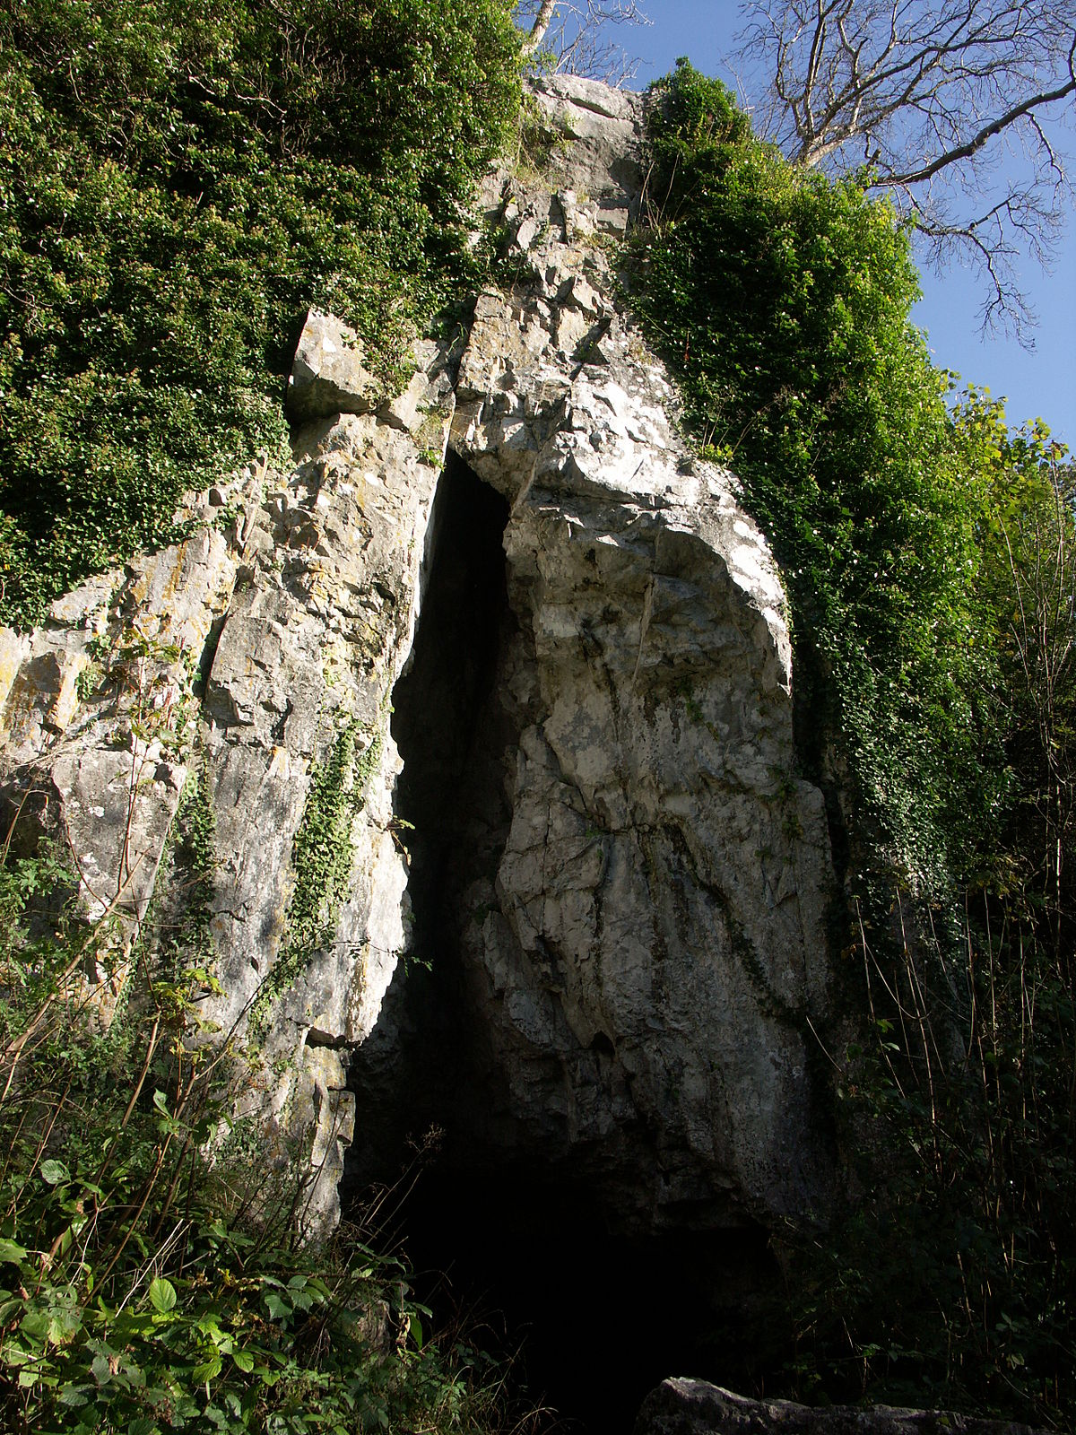
Notes:
1 - Scenery
2 - Dragon Attack
3 - Verrona Attack
4 - Abandoned Building
5 - A Great Fissure
6 - Commoners Passing
7 - Wyrmlings Passage
8 - Intriguing Opening
9 - Exynn Attacks
10 - Mystical Tower

Slide 9
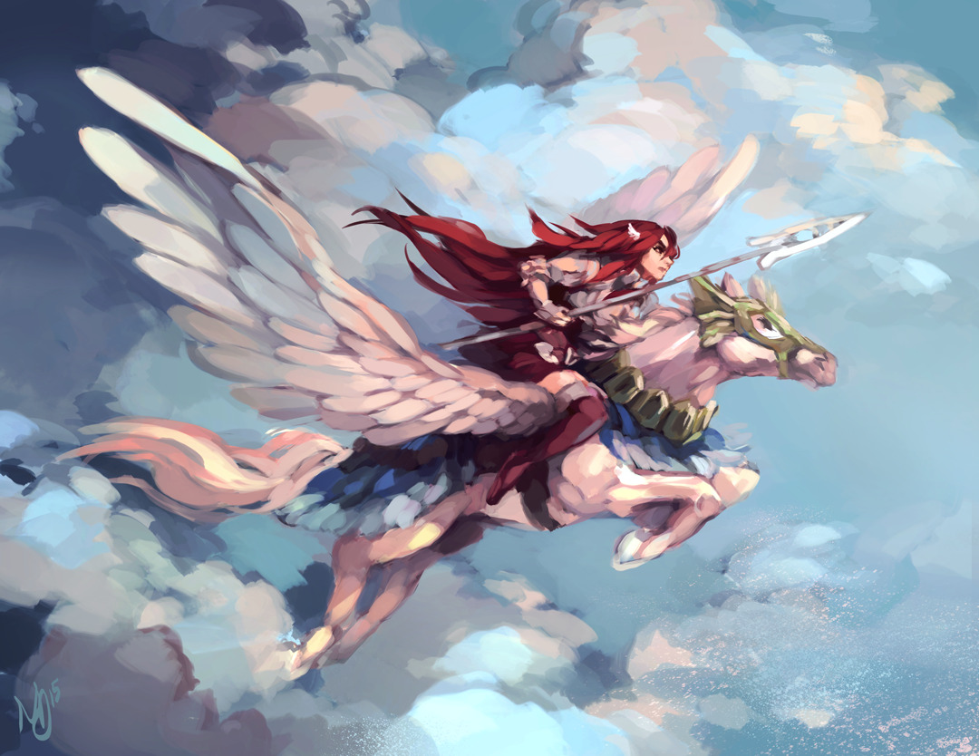
Notes:
1 - Scenery
2 - Dragon Attack
3 - Verrona Attack
4 - Abandoned Building
5 - A Great Fissure
6 - Commoners Passing
7 - Wyrmlings Passage
8 - Intriguing Opening
9 - Exynn Attacks
10 - Mystical Tower

Slide 10

Notes:
1 - Scenery
2 - Dragon Attack
3 - Verrona Attack
4 - Abandoned Building
5 - A Great Fissure
6 - Commoners Passing
7 - Wyrmlings Passage
8 - Intriguing Opening
9 - Exynn Attacks
10 - Mystical Tower

